Slide 1
Bayes VS. EWMA: A Portfolio Optimization Game
Harrison McKenny
Yanni Dalkos
Matthew Dempsey

Slide 3
Investment Game
2 Players: -one plays Bayesian one plays EWMA
1 Ref
Each applies their strategy to simulated historical returns
Players choose optimal weights
Winner is determined by seeing whose weights result in higher expected returns for the next period

Slide 4
Data composition
8 indices of data with 216 monthly observations
Bond indices for United States and European Union
Stock Indices for Canada, France, Germany, Japan, United Kingdom, and United States

Slide 5
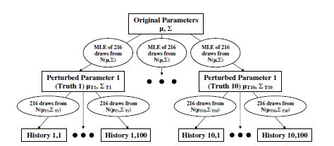
Data Creation

Slide 6


Difference Between Bayes & EWMA Portfolio Optimization
Covariance matrix calculations:
Baysian:
EWMA:
Notes:
Exponentially Weighted Moving Average
The EWMA model is a simple extension to the standard weighting scheme which assigns equal weight to every point in time for the calculation of the volatility, by assigning (usually) more weight to the most recent observations using an exponential scheme. This is effectively a restricted integrated GARCH.

Slide 7

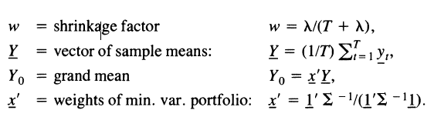

Difference Between Bayes & EWMA Portfolio Optimization (Continued)
Mean Vector Calculations
Bayesian:
EWMA:

Slide 8
Results

